Slide 1
Cloud Standards
Application :
A cloud application is the software architecture that the cloud uses to eliminate the need to install and run on the client computer.
There are many applications that can run, but there needs to be a standard way to connect between the client and the cloud.
HTTP :
The Hypertext Transfer Protocol (HTTP) as the computing mechanism to transfer data between the cloud and your organization.
HTTP is a stateless protocol. This is beneficial because hosts do not need to retain information about users between requests, but this forces web developers to use alternative methods for maintaining users’ states.
When a host needs to customize the content of a web site for a user, the web application must be written to track the user’s progress from page to page. The most common method for solving this problem is sending and receiving cookies.

Slide 2
Cloud Standards
HTTP is the language that the cloud and your computers use to communicate. This language isn’t hard to understand, and you’ve probably seen it before.
Say your browser wants to get a given web page. The browser initiates it by “saying”
GET/HTTP/1.0
Host: www.velte.com
The server responds with
HTTP/1.0 200 OK
Content-Type: text/html
<head>
<title>Thank you for visiting Velte Publishing. </title>
{The rest of the Velte Publishing web page appears here}
</body>
The first line of the browser’s request, GET/HTTP/1.0, tells us that the browser wants to see the site’s home page and that it is using version 1.0 of HTTP.
The second line, Host:www.velte.com, says which web site the browser wants to see.

Slide 3
Cloud Standards
HTTP 1.1 This example used HTTP 1.0, but current browsers use 1.1. The request and response would include a bit more information, but the differences are not distinct enough to go into.
The primary difference between the two is that originally, web browsers made separate HTTP requests like this for each page, each image, and every other component on the page.
Using HTTP 1.1, a browser and server can negotiate to leave the connection open and transfer all the page’s components without hanging up and opening new sessions.
Requests HTTP defines eight methods to describe how the desired action is to be performed on the server.
This server presents—whether pre-existing data or dynamically generated data depends on the implementation of the server.
HTTP is the most common way you will connect your browsers with the cloud. A protocol that is brewing is the XMPP.

Slide 4
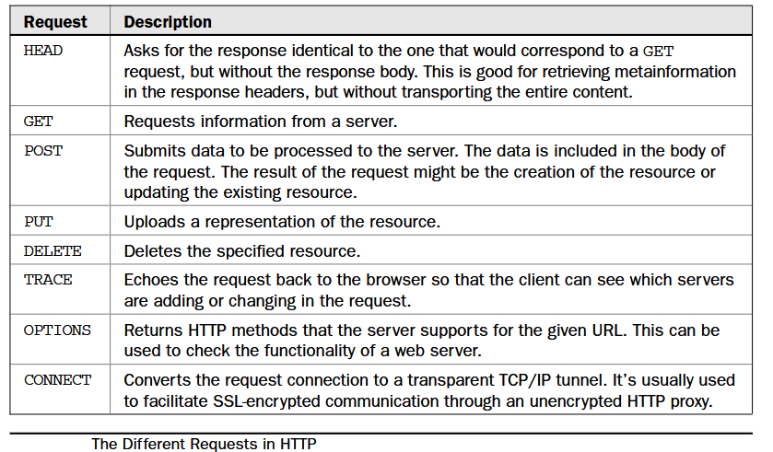
Cloud Standards

Slide 5
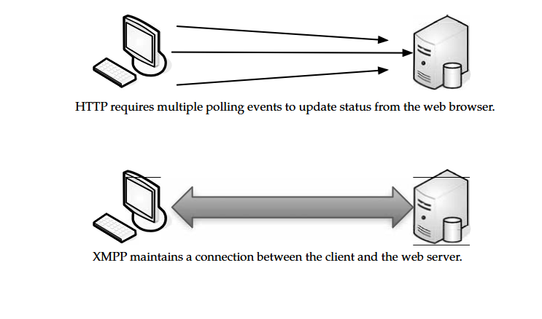
Cloud Standards
XMPP :
The Extensible Messaging and Presence Protocol (XMPP) is being talked about as the next big thing for cloud computing. T
The SOAP and other HTTP-based protocols are all one-way information exchanges. This means that clouds do not operate in real time and might have difficulties clearing a firewall. XMPP allows for two-way communication and eliminates polling.

Slide 6
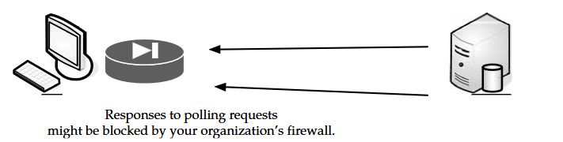
Cloud Standards
The Problem with Polling When you wanted to sync services between two servers, the most common means was to have the client ping the host at regular intervals. This is known as polling.
This is generally how we check our email. Every so often, we ping our email server to see if we got any new messages. It’s also how the APIs for most web services work.
The web site High Scalability reported in 2008 that Twitter was reporting an average of 200 to 300 connections per second, with spikes that rose as high as 800 requests per second.
During the Macworld keynote, the service went down because of so many polls. Some companies are trying to address the polling problem with existing protocols, but it is difficult.
Salesforce.com tries to do this by sending notifications back to your web service to avoid polling. That’s difficult for developers, and your firewall has to be configured to allow the messages back through.

Slide 7
Cloud Standards
Not Ready XMPP’s biggest problem is that it’s not HTTP. There’s a thought that anything new needs to be based on existing web standards, and while HTTP serves well, it’s not perfect, especially for cloud computing.
XMPP was developed for instant messaging and presence, and it is widely used in those circles. It includes the following features:
XMPP allows for easy two-way communication, eliminating the need for polling.
It is XML-based and easily extensible, which makes it ideal for cloud services.
It is efficient and able to scale to millions of concurrent users on a single service.
XMPP will gain in prevalence, but hopefully cloud vendors will make the move sooner rather than later.
Security
Securing your cloud sessions can be accomplished via encryption and authentication. The most prevalent means of web encryption comes standard on every browser. Authentication is another matter, with several options open to you.

Slide 8
Cloud Standards
Secure Sockets Layer (SSL) :
SSL is the standard security technology for establishing an encrypted link between a web server and browser. This ensures that data passed between the browser and the web server stays private.
To create an SSL connection on a web server requires an SSL certificate. When your cloud provider starts an SSL session, they are prompted to complete a number of questions about the identity of their company and web site.
The cloud provider’s computers then generate two cryptographic key a public key and a private key.
The public key does not need to be secret and is placed into a Certificate Signing Request (CSR). This is a file that contains your details. You then submit the CSR.
During the SSL certificate application process, the certification authority will validate your details and issue an SSL certificate, containing your details, allowing you to use SSL.
The cloud provider will then match your issued SSL certificate to your private key. Your web browser will be able to establish an encrypted link between your computer and the cloud provider.

Slide 9
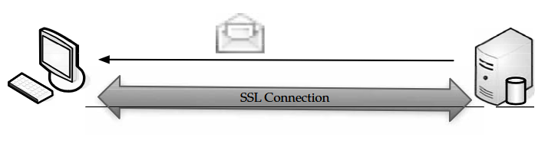
Cloud Standards
1. The browser checks the web site’s certificate to ensure that the site you are connecting to is the real site and not
someone else intercepting and spoofing the site.
2. The browser and web site decide on what type of encryption to use.
3. The browser and server send each other unique codes to use when encrypting information to be sent.
4. The browser and server use the encryption to start talking.
5. The browser shows the encrypting icon, and web pages are passed as secured.

Slide 10
Cloud Standards
The only difference you are likely to see is that the page takes a little longer to load because of all the behind the-scenes certificate passing.
The SSL certificate will contain your cloud provider’s domain name, company name, address, city, state, and country.
It will also contain the expiration date of the certificate and details of the certification authority responsible for issuing the certificate.
When a browser tries to connect securely to the cloud, it will retrieve the site’s SSL certificate and check that it has not expired and that it is being used by the web site for which it was issued.
It also checks to see if the certificate was issued by an authority that the browser trusts. If it fails any of these checks, the browser lets the user know that the site is not secured by SSL.

Slide 11
Cloud Standards
OpenID :
OpenID is an open-source solution for the problem of needing a unique username and password for access to different web sites, thus making your life simpler.
This allows you to choose the OpenID provider that best meets your need and that you trust. Also, OpenID can stay with you no matter which provider you move to.
Best of all, OpenID is free. This is good for businesses, because it means a lower cost for password and account management.
OpenID is still in the adoption phase and is becoming more popular as big names like AOL, Microsoft, Sun, and Novell begin to accept and provide OpenIDs.
OpenID is a product of the open-source community to solve problems that were not easily solvable by existing technology.
OpenID is a lightweight way to authenticate users, using the same technology that is used to identify web sites. Anyone can be an OpenID user or provider for free.

Slide 12
Cloud Standards
PCI DSS :
Payment Card Industry Data Security Standards (PCI DSS) requirement 2.2.1 is a nebulous area for many, especially as it relates to cloud computing.
The requirement states that an organization can “implement only one primary function per server.” But does that mean one physical server?
The short answer is “no.” You can have multiple systems that are virtualized; you just have to ensure that they are segmented and isolated from each other.
Virtualization is an emerging technology, and technology changes everything. In the past, copyright law was written to prevent you from making copies of movies and music.
At the time, no one dreamed that there would be a day when copyrighted materials could be saved on a computer or an iPod.
The copyright laws are written in such a way that all the bases are covered, no matter what technology throws at them. Expect PCI DSS rules to be changed as well.

Slide 13
Cloud Standards
How HTML Works :
HTML is a series of short codes typed into a text file by the author or created by web page design software. These short codes are called tags.
The text is then saved as an HTML file and viewed through a browser, like Internet Explorer or Mozilla Firefox. The browser reads the file and translates the text into the form the author wanted you to see.
Writing HTML can be done using a number of methods, with either a simple text editor or a powerful graphical editor.
Tags :
Tags are written between <angle brackets>. Tags are what allow things like tables and images to appear in a web page. Different tags perform different functions. The tags don’t appear when you view the page through a browser, but they affect how the browser behaves.
For instance: <b>This text will appear in bold.</b> But this text won't. In this example, the <b> tags were wrapped around some text, which will appear bold when viewed through an ordinary web browser.

Slide 14
Cloud Standards
Cascading Style Sheets in HTML :
Cascading Style Sheets (CSS) are used to control how pages are presented, and make pages more accessible. Basic special effects and interaction are provided by JavaScript, which adds a lot of power to basic HTML.
Dynamic HTML
Dynamic HTML (DHTML) is not a new specification of HTML, but rather a different way of looking at and controlling the standard HTML codes and commands.
When a regular HTML page loads, it will not change until another request comes to the server. DHTML gives you more control over the HTML elements, allowing them to change without returning to the web server.
There are four parts to DHTML:
• Document Object Model (DOM)
• Scripts
• Cascading Style Sheets (CSS)
• XHTML

Slide 15
Cloud Standards
DOM :
The Document Object Model (DOM) is what allows you to access your web page and make changes with DHTML. The DOM specifies every part of a web page, and provides consistent naming conventions, allowing you to access your web pages and change their properties.
Scripts :
The most common scripting languages in DHTML are JavaScript and ActiveX. Scripts are used to control the objects specified in the DOM.
Cascading Style Sheets in DHTML :
CSS is used in DHTML to control the look and feel of the web page. Style sheets list the colors and fonts of text, the background colors and images, and the placement of objects on the page. Using scripting and the DOM, you can change the style of various elements.
XHTML :
DHTML web pages are actually written in XHTML or HTML 4.x. DHTML is also used to build the elements for the CSS and the DOM to work on.

Slide 16
Cloud Standards
DHTML has four Features :
• Changing the tags and properties
• Real-time positioning
• Dynamic fonts
• Data binding
Changing the Tags and Properties One of the most common uses of DHTML is changing the qualities of an HTML tag, depending on an event outside of the browser. You can use this to preload information onto a page, but not display it until the user clicks a specific link.
Real-Time Positioning Real-time positioning allows objects, images, and text to move around the web page. Normally, this is used for interactive games, but it is a feature you may program into your cloud pages on the basis of organizational need.
Dynamic Fonts Dynamic fonts are a Netscape-only feature. Netscape developed this to avoid the problem designers had with not knowing which fonts would be on a reader’s system.

Slide 17
Cloud Standards
Fonts are encoded and downloaded with the page so that the page always looks the way the designer intended. Data Binding Data binding is an Internet Explorer only feature.
Microsoft developed the feature to allow easier access to databases and web sites. It is similar to using CGI to access a database, but uses an ActiveX control to function.
JavaScript :
Basic HTML does only basic stuff. It’s when you use JavaScript to write functions that are embedded in the HTML pages and interact with the DOM that you start adding pizzazz and specific user-entered data that adds functionality to your web pages.
Examples of the uses of JavaScript:
• Opening or popping up new windows, and having control of the size and attributes of the Window.
Validating web form input values to ensure that they will be accepted before submitting them to the server.
• Changing images as the cursor rolls over them

Slide 18
Cloud Standards
JavaScript is a scripting language used for client-side web development. JavaScript was influenced by many languages and was designed to look like Java but be easier for non programmers to work with.
It is best known for its use in web sites, it is also being used to enable scripting access to objects embedded in other applications.
It has very little to do with the Java programming language, although both use the common C syntax and JavaScript uses many Java names and naming conventions.
It would appear to be a “lite” version of the Java programming language. The name comes from a marketing agreement between Sun and Netscape in exchange for Netscape bundling Sun’s Java Runtime with the then-dominant browser.
JavaScript runs locally on a user’s browser rather than on the server, so it responds quickly to user actions. Further, JavaScript code can detect user action, which HTML cannot, like sensing individual keystrokes. Web browsers use the public API to create host objects, which are responsible for reflecting the DOM into JavaScript.
A JavaScript web server would house the host objects representing an HTTP request and response, then a JavaScript program could manipulate the data to dynamically generate a web page.

Slide 19
Cloud Standards
A sample JavaScript program:
<!DOCTYPE HTML PUBLIC "-//W3C//DTD HTML 4.01//EN"
"http://www.w3.org/TR/html4/strict.dtd">
<html>
<head><title>simple page</title></head>
<body>
<script type="text/javascript">
document.write('Hello World!');
</script>
<noscript>
<p>Your browser either does not support JavaScript, or you have
JavaScript turned off.</p>
</noscript>
</body>
</html>

Slide 20
Cloud Standards
Infrastructure :
Infrastructure is a way to deliver virtualization to your cloud computing solution. We talked about virtualization before, both across the Internet and locally.
Virtualization :
Virtualization is somewhat different, and major players worked together to develop a standards.
VMware, AMD, BEA Systems, BMC Software, Broadcom, Cisco, Computer Associates International, Dell, Emulex, HP, IBM, Intel, Mellanox, Novell, QLogic, and Red Hat all worked together to advance open virtualization standards.
VMware says that it will provide its partners with access to VMware ESX Server source code and interfaces under a new program called VMware Community Source.
This program is designed to help partners influence the direction of VMware ESX Server through a collaborative development model and shared governance process.

Slide 21
Cloud Standards
“Virtualization is gaining widespread adoption due to its indisputable customer benefits. It is an area rich in opportunities and the ecosystem will develop most fully with open standards.
VMware is thus taking our industry-leading products, opening up the APIs and providing shared governance and source access to them,” said Diane Greene, president of VMware.
It is the best possible way to give customers the ability to realize the full potential of the x86 virtualization layer.”
These initiatives are intended to benefit end users by the following :
Expanding virtualization solutions The availability of open-standard virtualization Interfaces and the collaborative nature of VMware Community Source are intended to accelerate the availability of new virtualization solutions.
Expanded interoperability and supportability Standard interfaces for hypervisors are expected to enable interoperability for customers with heterogeneous virtualized environments.
Accelerated availability of new virtualization-aware technologies Vendors across the technology stack can optimize existing technologies and introduce new technologies for running in virtual environments.

Slide 22
Cloud Standards
Open Hypervisor Standards :
Hypervisors are the foundational component of virtual infrastructure and enable computer system partitioning. An open-standard hypervisor framework can benefit customers by enabling innovation across an ecosystem of interoperable virtualization vendors and solutions.
VMware contributed an existing framework of interfaces, called Virtual Machine Hypervisor Interfaces (VMHI), based on its virtualization products to facilitate the development of these standards in an industry-neutral manner.
Consistent adoption of open interfaces is expected to facilitate interoperability and supportability across heterogeneous virtualized environments.
Collaboration around open hypervisor standards is expected to focus on the following areas of interoperability and performance optimization for virtualized environments:
Cross-platform frameworks that govern the standardized operation and management of stand-alone virtual machine environments as well as highly dynamic, data center-scale deployment of virtualized systems
Cooperative virtualization APIs between hypervisors and guest operating systems
Virtual machine formats that enable virtual machine migration and recovery across platforms

Slide 23
Cloud Standards
Community Source :
The Community Source program provides industry partners with an opportunity to access VMware ESX Server source code under a royalty-free license.
Partners can contribute shared code or create binary modules to spur and extend interoperable and integrated virtualization solutions.
The idea is to combine the best of both the traditional commercial and open-source development models. Community members can participate and influence the governance of VMware ESX Server through an architecture board.
This approach will help drive open collaboration while still preserving the ability of partners to build differentiated, intellectual property protected solutions.
For customers, the VMware Community Source program is expected to yield a richer and broader set of partner solutions that are well integrated with VMware virtual infrastructure products.
For partners, the source access and development model allows them to efficiently deliver complementary solutions or differentiated product capabilities around the VMware ESX Server code base.

Slide 24
Cloud Standards
Red Hat applauds the efforts of technology partners like VMware who are working to establish open, standards-based solutions,” said Paul Cormier, executive vice president of engineering at Red Hat.
“VMware, partners and the community to offer customers virtualization as a key component of their open source architectures.”
OVF :
Open Virtualization Format (OVF). OVF describes how virtual appliances can be packaged in a vendor-neutral format to be run on any hypervisor.
It is a platform-independent, extensible, and open specification for the packaging and distribution of virtual appliances composed of one or more virtual machines.
OVF gives customers and developers the choice to select any hypervisor based on price, preference, or functionality, and it prevents vendor lock-in.
This standard packaging and distribution format for virtual appliances will be important in accelerating the adoption of virtual appliances.

Slide 25
Cloud Standards
Vmware features :
Optimized for distribution
Enables the portability and distribution of virtual appliances
Supports industry-standard content verification and integrity checking
Provides a basic scheme for the management of software licensing
A simple, automated user experience
Enables a robust and user-friendly approach to streamlining the installation process
Validates the entire package and confidently determines whether each virtual machine should be installed
Verifies compatibility with the local virtual hardware
Portable virtual machine packaging
Enables platform-specific enhancements to be captured
Supports the full range of virtual hard disk formats used for virtual machines today, and is extensible to deal with future formats that are developed
Captures virtual machine properties concisely and accurately

Slide 26
Cloud Standards
Vendor and platform independent :
Does not rely on the use of a specific host platform, virtualization platform, or guest operating system
Extensible :
Designed to be extended as the industry moves forward with virtual appliance technology
Localizable :
Supports user-visible descriptions in multiple locales
Supports localization of the interactive processes during installation of an appliance
Allows a single packaged appliance to serve multiple market opportunities
It seems logical that VMware would take the lead in the development of the standard, as they are one of the most dominant forces in the world of virtualization.
It is also encouraging that they opened their own code to partners to make the standard a true industry-developed standard

Slide 27
Cloud Standards
Service :
A web service, as defined by the World Wide Web Consortium (W3C), “is a software system designed to support interoperable machine-to-machine interaction over a network” that may be accessed by other cloud computing components.
Web services are often web APIs that can be accessed over a network, like the Internet, and executed on a remote system that hosts the requested services.
Data :
Data can be stirred and served up with a number of mechanisms; two of the most popular are JSON and XML.
Both are based on leading industry standards HTML and JavaScript. to help deliver and present data.

Slide 28
Cloud Standards
JSON :
JSON is short for JavaScript Object Notation and is a lightweight computer data interchange format.
It is used for transmitting structured data over a network connection in a process called serialization. It is often used as an alternative to XML.
JSON Basics JSON is based on a subset of JavaScript and is normally used with that language.
JSON is considered to be a language-independent format, and code for parsing and generating JSON data is available for several programming languages.
This makes it a good replacement for XML when JavaScript is involved with the exchange of data, like AJAX.

Slide 29
Cloud Standards
XML vs. JSON :
JSON should be used instead of XML when JavaScript is sending or receiving data. The reason for this is that when you use XML in JavaScript, you have to write scripts or use libraries to handle the DOM objects to extract the data you need.
In JSON, the object is already an object, so no extra work needs to be done. This reduces the amount of overhead, CPU use, and the amount of code you or your programmers have to write.
Example The following is a sample JSON representation of an object describing a person:
{ "firstName": "Johnny",
"lastName": "Johnson", "address": {
"streetAddress": "123 Main Street", "city": "Minneapolis", "state": "MN",
"postalCode": 55102},
"phoneNumbers": ["612 555-9871", "952 555-1598"] }

Slide 30
Cloud Standards
XML :
Extensible Markup Language (XML) is a standard, self-describing way of encoding text and data so that content can be accessed with very little human interaction and exchanged across a wide variety of hardware, operating systems, and applications.
XML provides a standardized way to represent text and data in a format that can be used across platforms. It can also be used with a wide range of development tools and utilities.
XML Basics XML is very similar to HTML so those who already know HTML will find it easy to pick up XML.
Separation of form and content HTML uses tags to define the appearance of text, while XML tags define the structure and the content of the data. Individual applications will be specified by the application or associated style sheet.
XML is extensible Tags can be defined by the developer for specific application, while HTML’s tags are defined by W3C.

Slide 31
Cloud Standards
Functionality XML makes database use much easier for your organization.
Relational database systems cannot meet all the demands of electronic business because they process data independently from its context.
They are also unable to handle rich data, like audio, video, or nested data structures, which are common in cloud environments.
Traditional databases are usually retrofitted to deal with XML, but the conversion process is prone to error and there’s a lot of overhead, especially with greater transaction rates and document complexity.
XML databases smooth out this process because they store XML natively in structured, hierarchical form.
Queries can be resolved much more quickly because there is no need to map the XML data tree to relational database tables.

Slide 32
Cloud Standards
Benefits of XML :
Self-describing data XML does not require relational schemata, file description tables, external data type definitions, and so forth. Also, while HTML only ensures the correct presentation of the data, XML also guarantees that the data is usable.
Database integration XML documents can contain any type of data from text and numbers to multimedia objects to active formats like Java.
No reprogramming if modifications are made Documents and web sites can be changed with XSL Style Sheets, without having to reprogram the data.
One-server view of data XML is exceptionally ideal for cloud computing, because data spread across multiple servers looks as if it is stored on one server.
Open and extensible XML’s structure allows you to add other elements if you need them. You can easily adapt your system as your business changes.
Future-proof The W3C has endorsed XML as an industry standard, and it is supported by all leading software providers. It’s already become industry standard in fields like healthcare.

Slide 33
Cloud Standards
Contains machine-readable context information Tags, attributes, and element structure provide the context for interpreting the meaning of content, which opens up possibilities for development.
Content vs. presentation XML tags describe the meaning of the object, not its presentation. That is, XML describes the look and feel of a document, and the application presents it as described.
Web Services :
Web services describe how data is transferred from the cloud to the client. REST and SOAP work, and which would be best for your cloud needs.
REST :
Representational state transfer (REST) is a way of getting information content from a web site by reading a designated web page that contains an XML file that describes and includes the desired content.
For instance, REST could be used by your cloud provider to provide updated subscription information. The provider could prepare a web page that includes content and XML statements that are described in the code.
Subscribers only need to know the uniform resource locator (URL) for the page where the XML file is located, read it with a web browser, understand the content using XML information, and display it appropriately.

Slide 34
Cloud Standards
REST was developed in a PhD dissertation by Roy Fielding, and he calls it an “architectural style.” He says REST exploits existing technology and protocols of the Web including HTTP and XML.
REST is similar in function to the Simple Object Access Protocol (SOAP), but is easier to use. SOAP requires writing or using a data server program and a client program. However, SOAP offers more capability.
For instance, if you were to provide syndicated content from your cloud to subscribing web sites, those subscribers might need to use SOAP, which allows greater program interaction between the client and the server.
REST uses the same publishing approach that many sites use with RDF Site Summary (RSS). RSS uses the Resource Description Framework (RDF), which is a standard way to describe a web site.
Resources are sources of specific information and each one is referenced by a global identifier, like a URL in HTTP. To manipulate these resources, network components communicate via a standard interface and exchange representations of the resources.
For instance, a resource, which is a triangle, might be described as a polygon with three sides of equal length. It may also combine three points that are connected in a comma separated list.

Slide 35
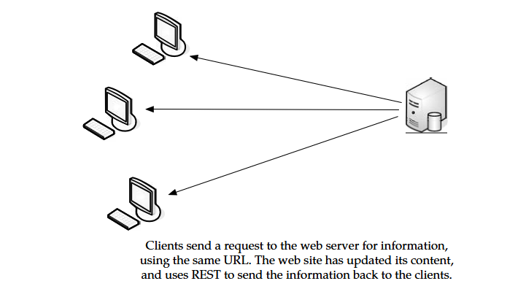
Cloud Standards

Slide 36
Cloud Standards
Benefits REST :
It gives better response time and reduced server load due to its support for the caching of representations.
Server scalability is improved by reducing the need to maintain session state.
A single browser can access any application and any resource, so less client-side software needs to be written.
A separate resource discovery mechanism is not needed, due to the use of hyperlinks in representations.
Better long-term compatibility and evolvability characteristics exist than in RPC.
The ability of documents, like HTML, to evolve with both forward- and backward-compatibility.
Resources can add support for new content types as they are defined, without eliminating support for older content types.
A benefit when using RESTful applications on the cloud is that REST allows users to bookmark specific queries and allows those queries to be sent to others via email or instant messaging.
This “representation” of a path or entry point into an application becomes very portable.

Slide 37
Cloud Standards
SOAP :
Simple Object Access Protocol (SOAP) is a way for a program running in one kind of operating system to communicate with a program in the same or another kind of an operating system (such as Linux) by using HTTP and XML as the tools to exchange information.
Procedure Calls Often, remote procedure calls (RPC) are used between objects like DCOM or COBRA, but HTTP was not designed for this use. RPC is a compatibility problem, because firewall and proxy servers will block this type of traffic.
Web protocols already are installed and available for use by the major operating systems, HTTP and XML provide an easy solution to the problem of how programs running under different operating systems in a network can communicate with each other.
SOAP describes exactly how to encode an HTTP header and an XML file so that a program on one computer can call a program in another computer and pass it information.
It also explains how a called program can return a response.

Slide 38
Cloud Standards
One of the advantages of SOAP is that program calls are more likely to get through firewalls that normally screen out requests for those applications.
HTTP requests are normally allowed through firewalls, programs using SOAP can communicate with programs anywhere.
Sample When you look at the following SOAP example, you can see how it is based on HTTP. In fact, the first line in the request is nearly identical to a standard HTTP request.
Here is the request fully written out:
POST /InStock HTTP/1.1
Host: www.example.org
Content-Type: application/soap+xml; charset=utf-8
Content-Length: nnn
<?xml version="1.0"?>
<soap:Envelope
xmlns:soap="http://www.w3.org/2001/12/soap-envelope"
soap:encodingStyle="http://www.w3.org/2001/12/soap-encoding">

Slide 39
Cloud Standards
<soap:Body xmlns:m="http://www.example.org/stock">
<m:GetStockPrice>
<m:StockName>IBM</m:StockName>
</m:GetStockPrice>
</soap:Body>
</soap:Envelope>
And like a standard HTTP response, a SOAP response follows the similar format. Here is a sample SOAP response:
HTTP/1.1 200 OK
Content-Type: application/soap+xml; charset=utf-8
Content-Length: nnn
<?xml version="1.0"?>
<soap:Envelope
xmlns:soap="http://www.w3.org/2001/12/soap-envelope"
soap:encodingStyle="http://www.w3.org/2001/12/soap-encoding">
<soap:Body xmlns:m="http://www.example.org/stock">
<m:GetStockPriceResponse> <m:Price>34.5</m:Price> </m:GetStockPriceResponse>
</soap:Body>
</soap:Envelope>

